Slide 1
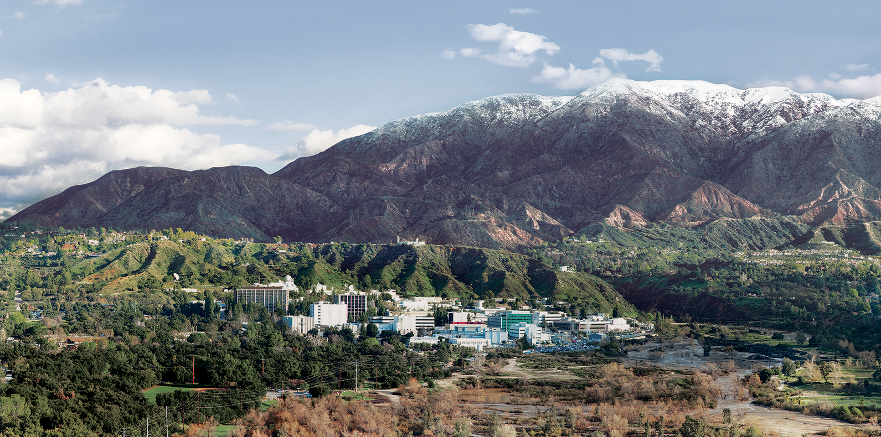
1. Introduction to Imaging Spectroscopy
Dr. David R. Thompson
Jet Propulsion Laboratory, Imaging Spectroscopy Group

Slide 2
Goals for this module
Interpret imaging spectrometer measurements
Understand the difference between radiance and reflectance
Understand differences between spectroscopic and image domain analyses

Slide 3
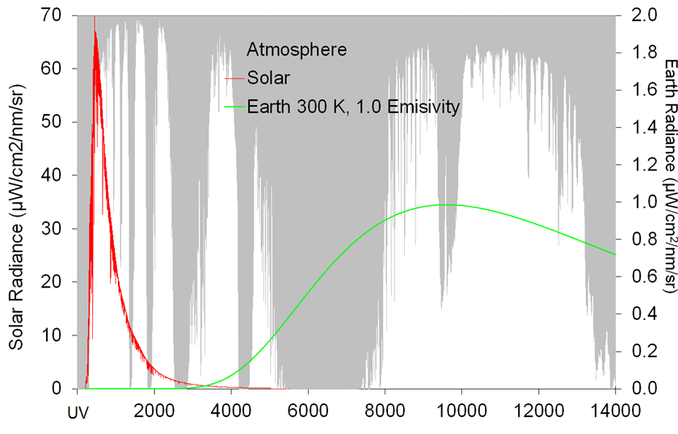
Dramatis Persone
Solar Radiance
Thermal Emission
Wavelength (nm)

Slide 4
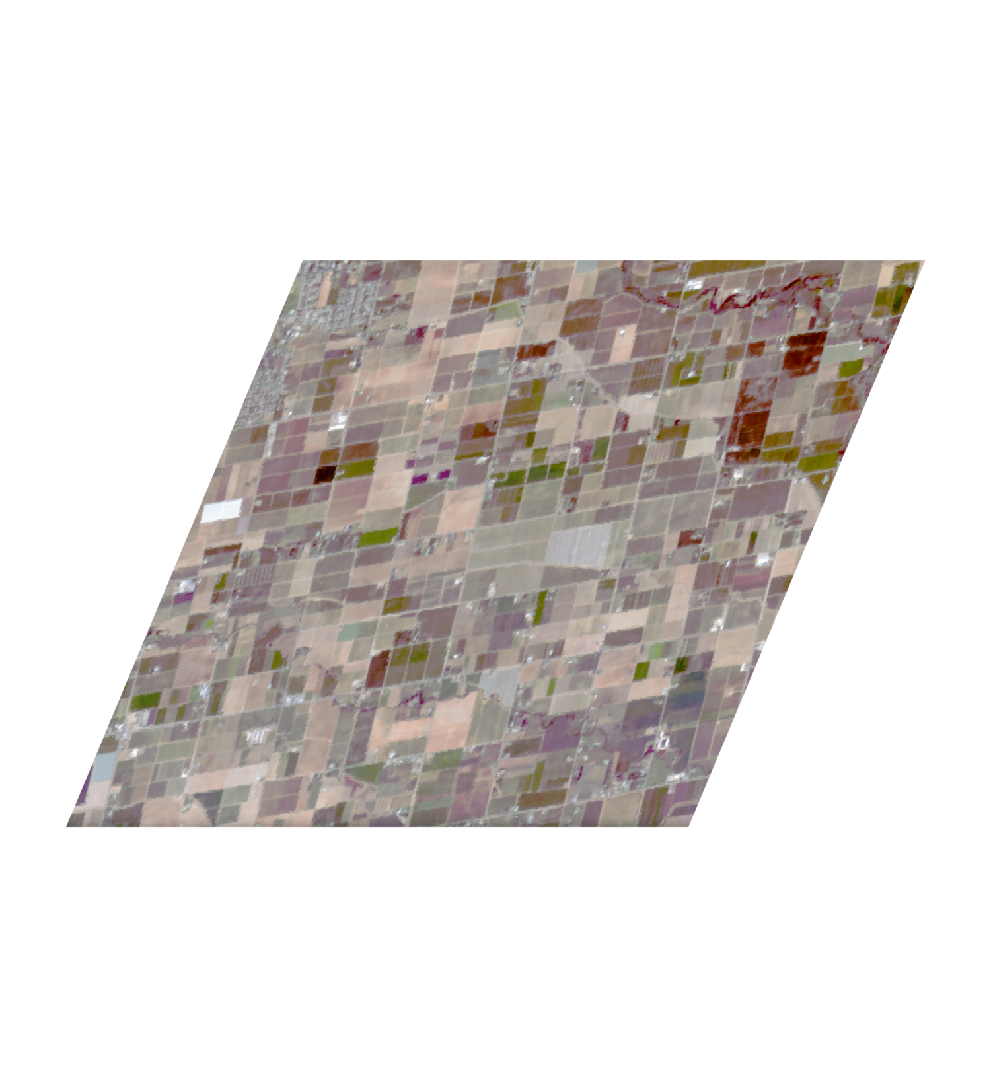
Measurement process – 100s of parallel spectrometers
Detector Array
Spectrometer
Slit
Telescope

Slide 5

From radiance to surface reflectance
Instrument
Scattering
Absorption
Atmosphere
Reflection
Surface

Slide 6
Deep water vapor absorption features
Shallow vapor absorption features (correctable)
Deep vapor absorption features (no signal!)
Features near 1380 nm and 1880 nm, and beyond 2500 nm, are nearly opaque due to strong water vapor absorption.
This results in a noisy reflectance estimate.
Exclude these intervals from your calculations!

Slide 7
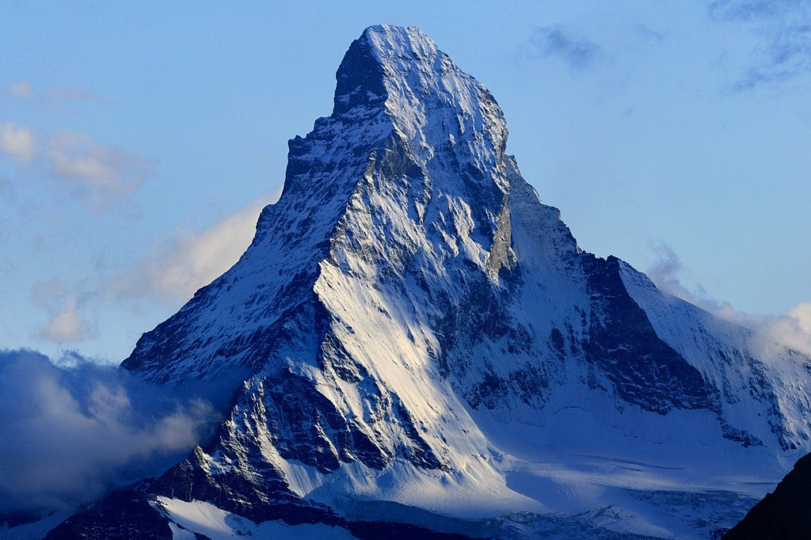
Reflectance Spectrum: Snow
Zacharie Grossen - Camptocamp.org
Snow grain size (microns)
Ice grain size (microns)
Niklas Bohn et al., in preparation

Slide 8
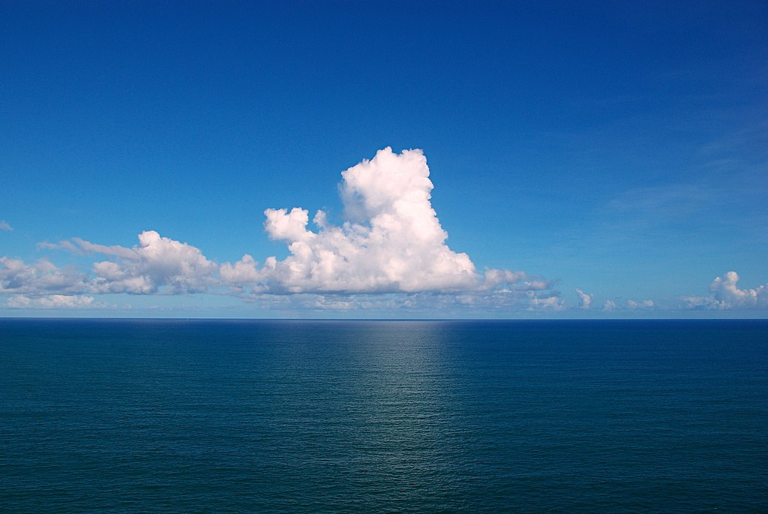
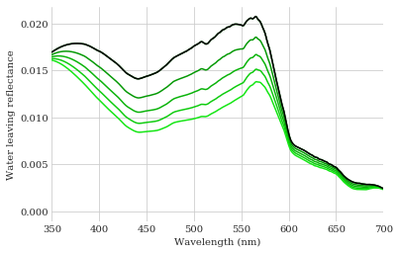
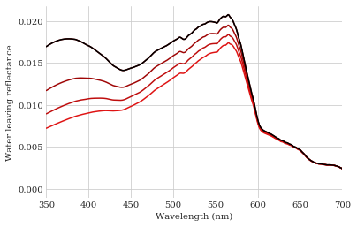
Reflectance Spectrum: Water
Image: Tiago Fioreze
Increasing Colored Dissolved Organic Matter
Increasing Phytoplankton

Slide 9
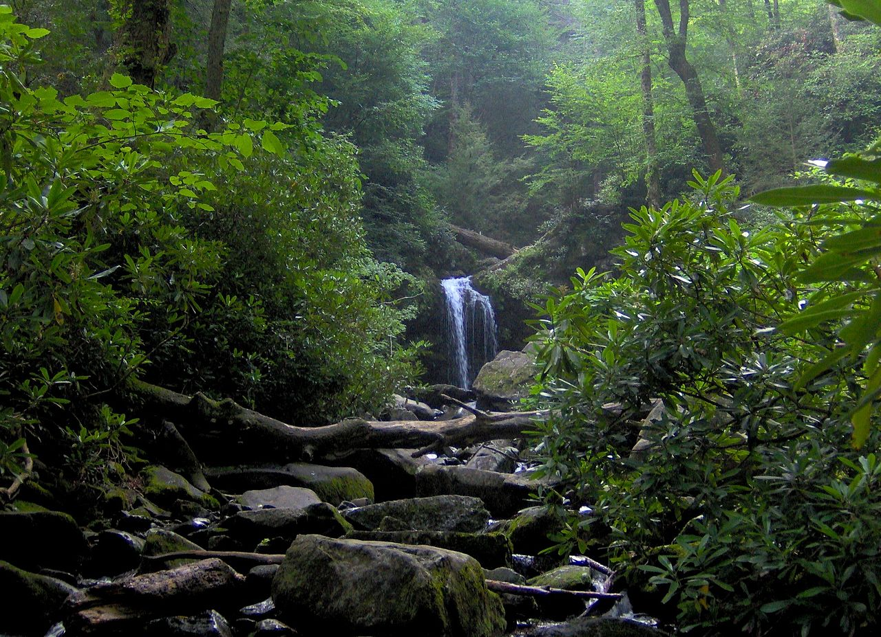
Reflectance Spectrum: Vegetation
Credit: I,Bms4880, Roaring Fork, Great Smoky Mountains (Wikipedia)
Spectra from USGS spectral library version 7.0
Increasing Nonphotosynthetic Vegetation
Increasing Soil Fraction

Slide 10
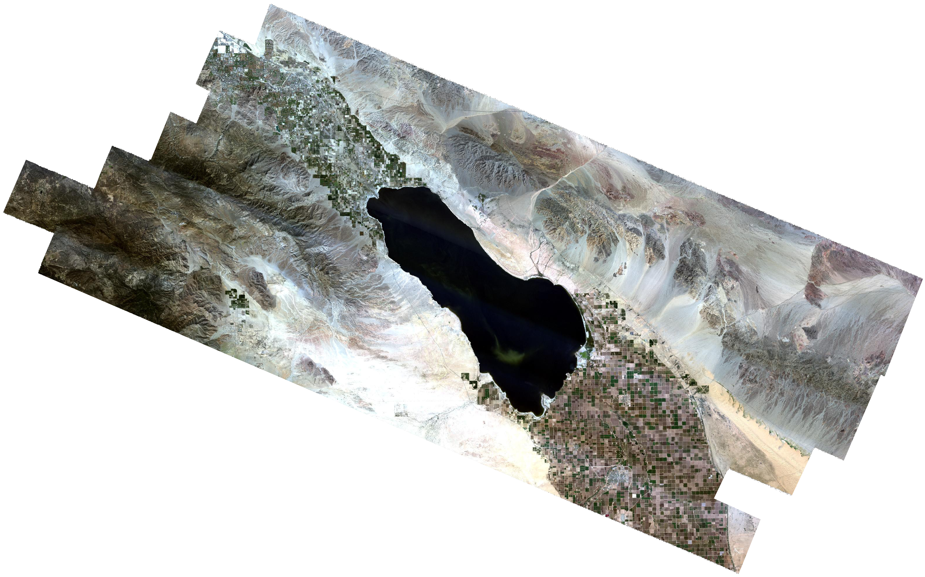
Example: Geologic Mapping via absorption fits
Mineral absorption
Surface Reflectance
(Salton Sea, CA)

Slide 11
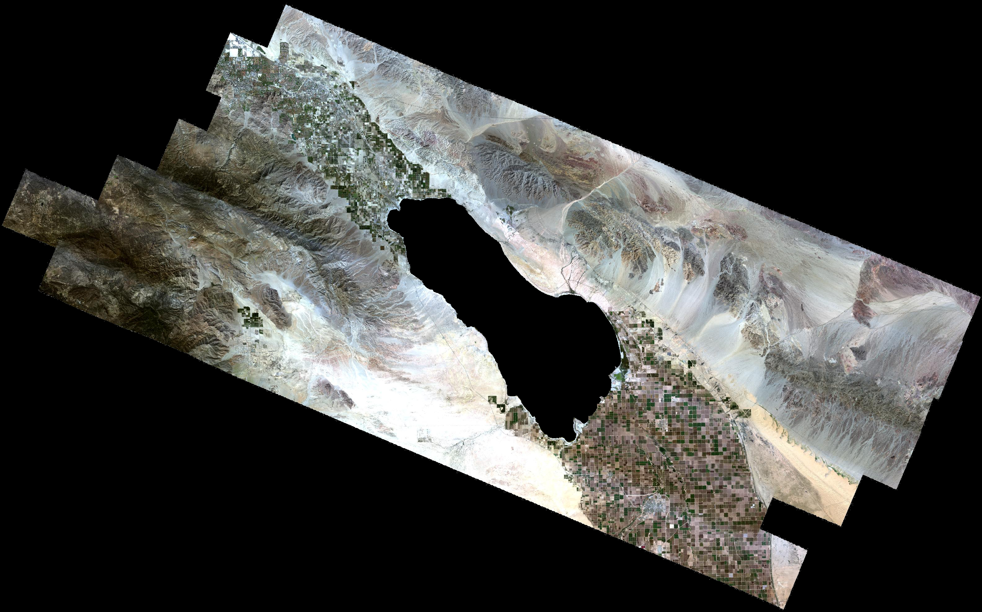
Salton Sea, CA (AVIRIS instrument)
Courtesy NASA/JPL/Roger Clark

Slide 12
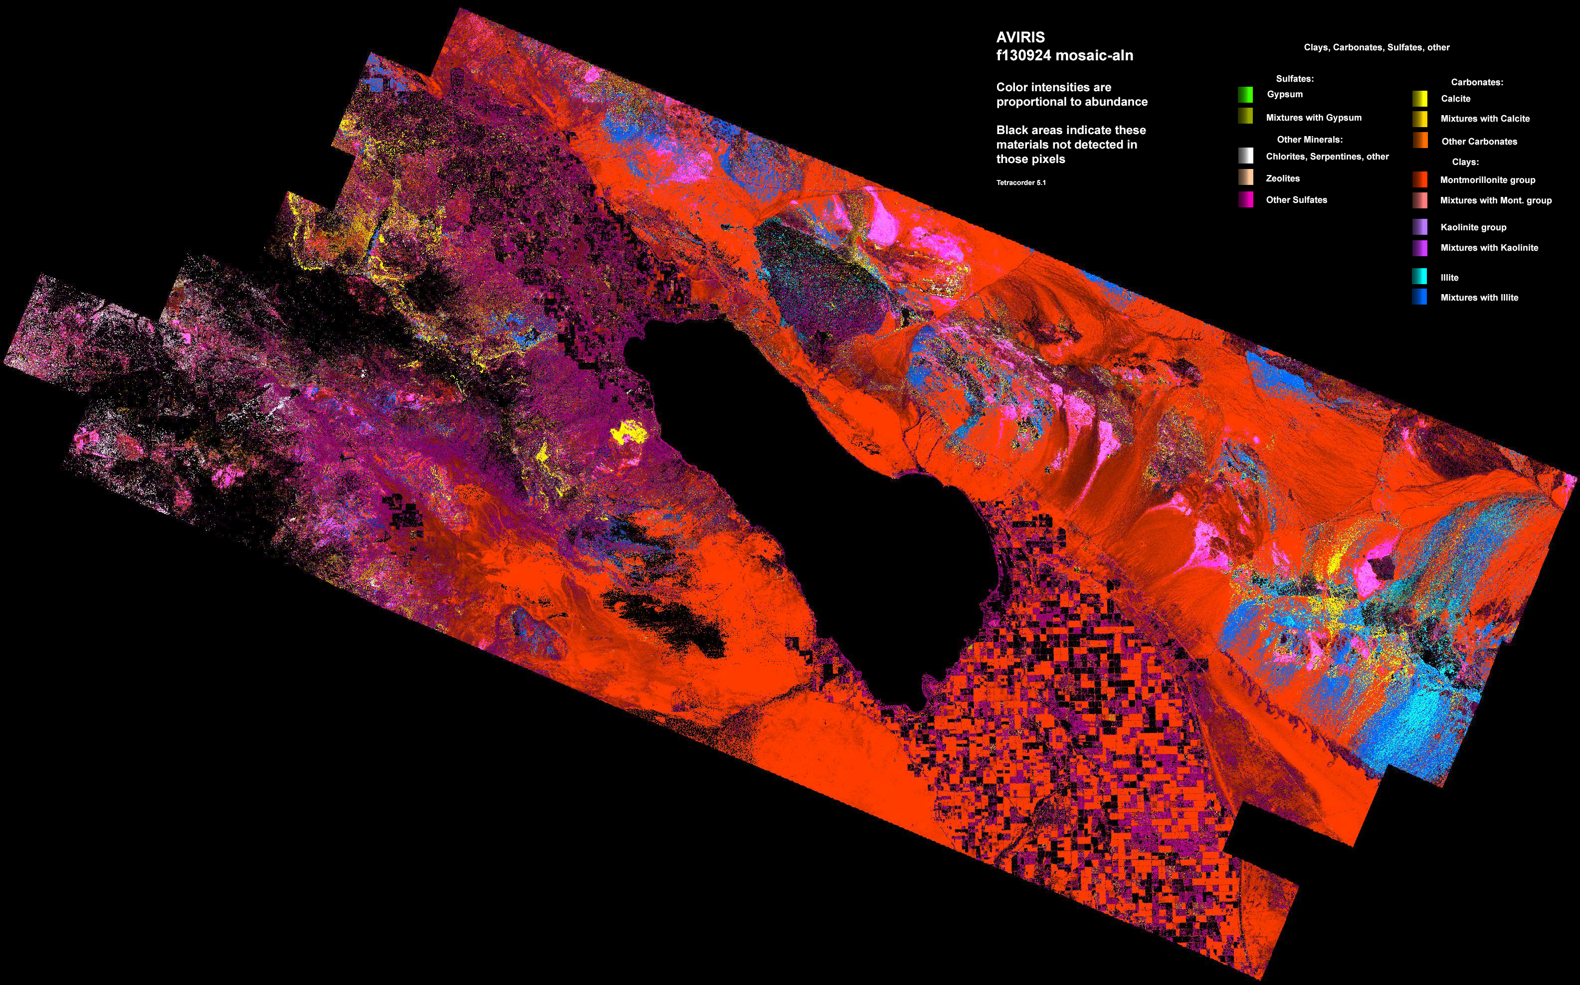
Salton Sea, CA (AVIRIS instrument)
Courtesy NASA / JPL / USGS / R. Clark
Salton Sea
Mineral Map
50km
Courtesy NASA/JPL/Roger Clark

Slide 13
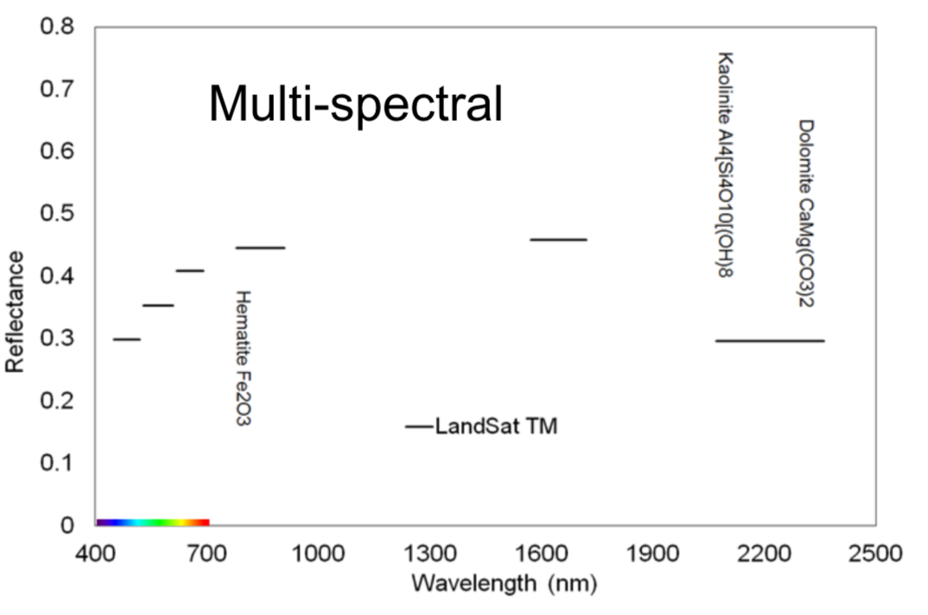
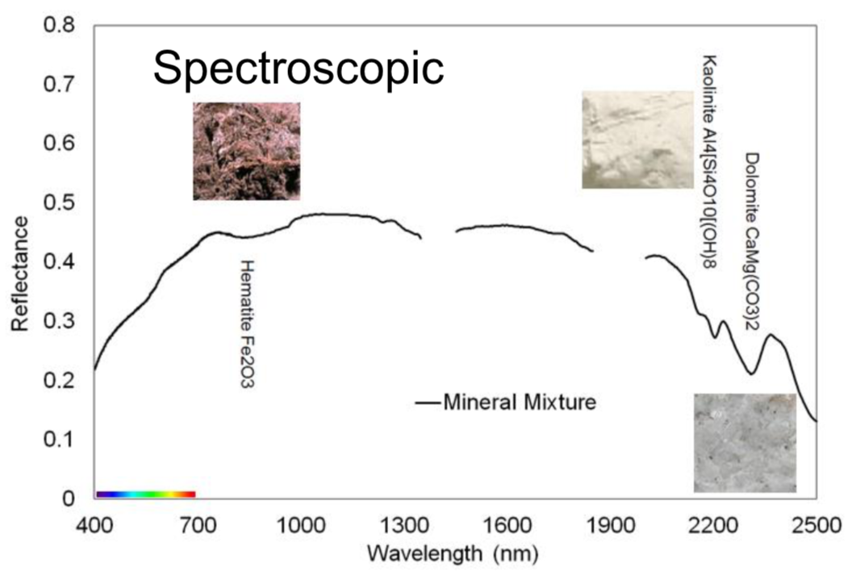
Imaging spectroscopy vs. multiband analysis
Images courtesy Robert O. Green, JPL
Multiband |  | Imaging Spectroscopy
Typically built with optical filters |  | Uses dispersive elements (e.g. gratings)
1-10s of bands |  | 100s of channels
Image-space (morphological) analyses |  | Spectroscopy using each pixel independently
Band math, thresholds, trees |  | Feature fitting and shape matching
Often mathematically underdetermined |  | Often mathematically overdetermined
Analyses are often qualitative |  | Quantitative measurement with uncertainties
Empirical modeling |  | Empirical or physics-based modeling

Slide 14
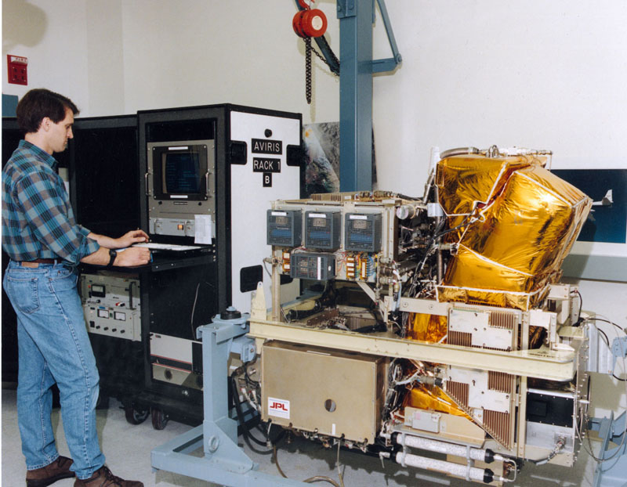
AVIRIS Classic (JPL, 1986)
airbornescience.nasa.gov

Slide 15
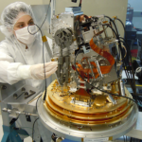
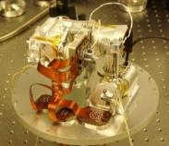
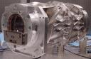
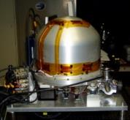
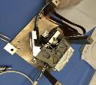
Recent instruments
AVIRIS-NG 2012
UCIS 2013
CWIS 2015
PRISM 2012
ESWIRS 2014

Slide 16
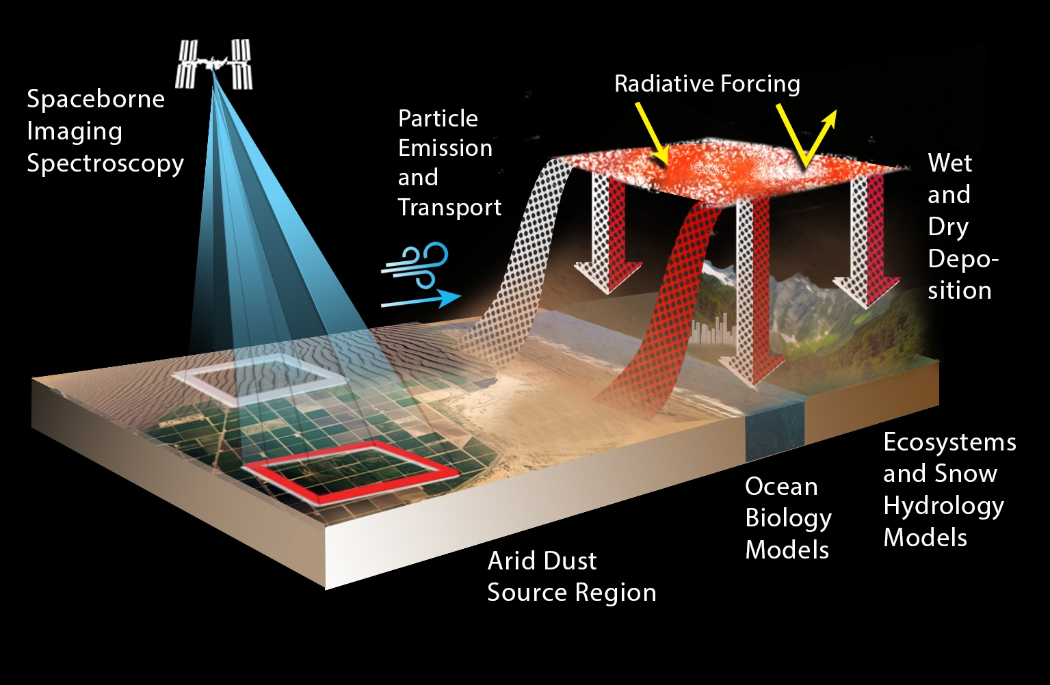
Earth Mineral dust source InvesTigation (EMIT)
Image: NASA / JPL

Slide 17
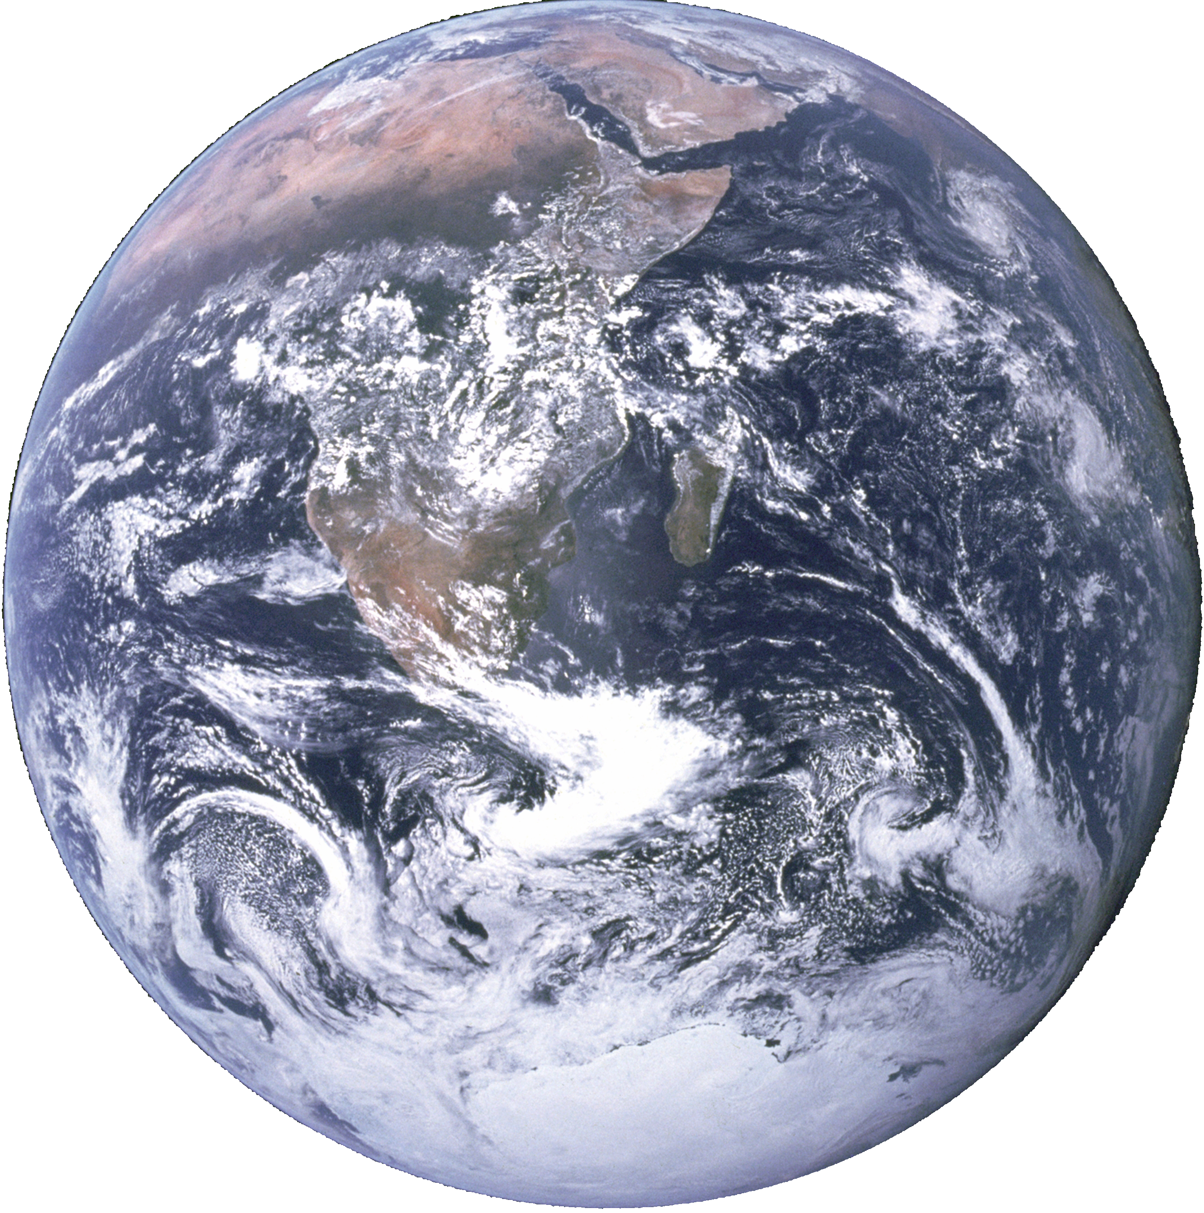
Recommended Decadal Survey Investigation: SBG (NASA)
Global VSWIR
Targeted VSWIR
Targeted VNIR
Upcoming orbital Investigations
EMIT (NASA)
ENMAP (DRL)
HISUI (Japan, METI)
AHSI (China)
Hyperion (NASA Pathfinder)
PRISMA (ISA)
HICO (ONR/NASA)
DESIS (DRL)
CHRIS/PROBA (ESA)
2000 2005 2010 2015 2020 2025 2030

Slide 19
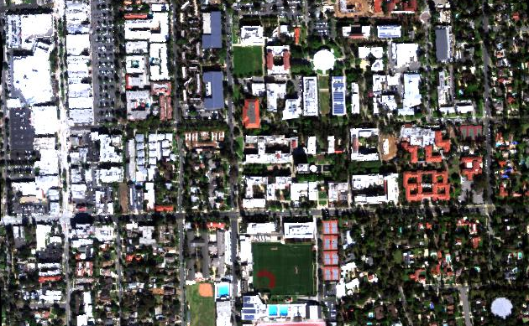
Exercise 1: Scavenger hunt
You have a data cube of reflectances acquired by the AVIRIS-NG instrument over the California Institute of Technology. Find the following spectra in the scene… what material(s) does each represent?
N
100 m

Slide 20
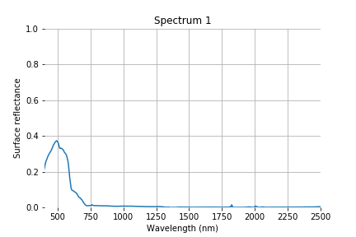
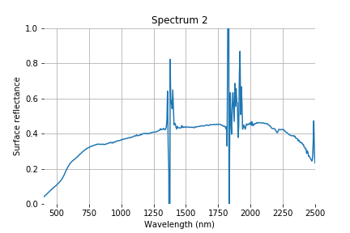
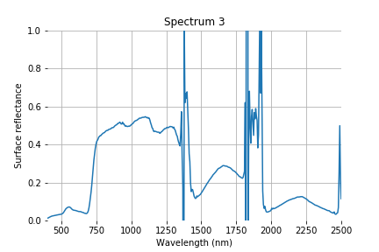
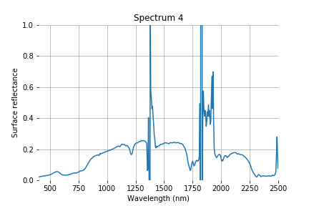
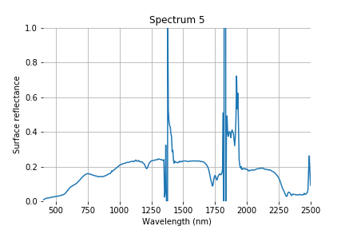
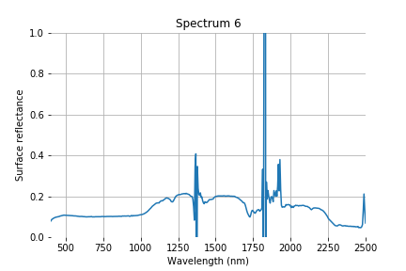
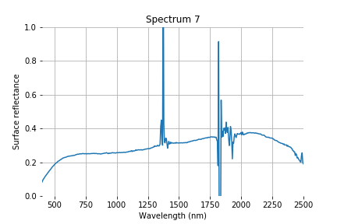
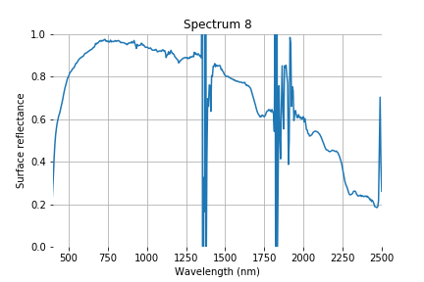
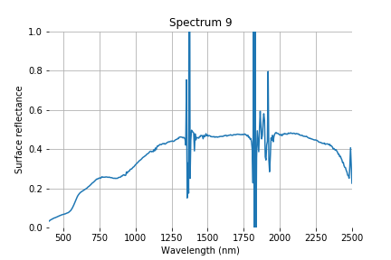
Targets

Slide 21
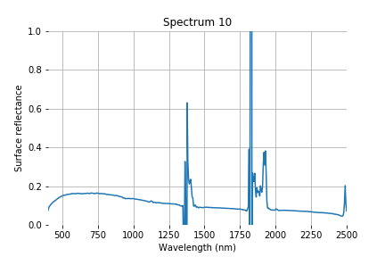
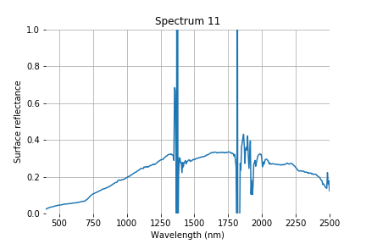
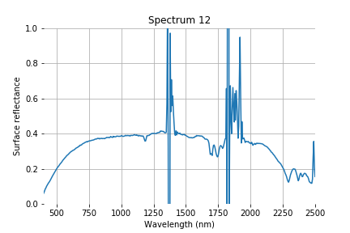
Targets

